Slide 1

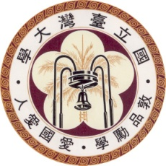
Clustering Approach for Solving Traveling Salesman Problems via Ising Model Based Solver
From: DAC2020（ACM/IEEE Design Automation Conference 2020）
Author: Akira Dan, Riu Shimizu, Takeshi Nishikawa, Song Bian, Takashi Sato (Kyoto University)
Presenter: Ting-Yi Wu
Instructor: Jie-Hong Roland Jiang
ALCom Lab

Slide 2
Outline
Introduction
Background
Hierarchical ising model solver
Conclusion
Refernce

Slide 3
i. INtroduction

Slide 4
Introduction
Combinatorial optimization problems are abundant in the real world, development of efﬁcient solvers for such problems is important.
Problem size
Ising model-based solvers have recently attracted increased attention as efﬁcient methods for ﬁnding approximate solutions to combinatorial optimization problems.

Slide 5
Ising model
Statistical model representing the spin
Atomic spins in two states(+1 or -1)
+1 : up
-1 : down
Two procedures:
Anneling:
State transition that lowers the local energy by the interaction with adjacent spins
Random flip:
A stochastic state transition to help escape from local minima

Slide 6
The traveling salesman problem (TSP)
Well-known combinatorial optimization problem
Find the route with the lowest total travel cost for visiting all cities
Can be applied to a wide range of problems
Printed circuit board wiring
Transportation route planning
Scheduling
Protein structure analysis

Slide 7
Solving TSPs using the Ising model-based solver
n-cities are modeled by a lattice-like graph that uses n²
City number
Visit order
The objective function is formulated as the summation of the distances along the route and the number of constraint violations.

Slide 8
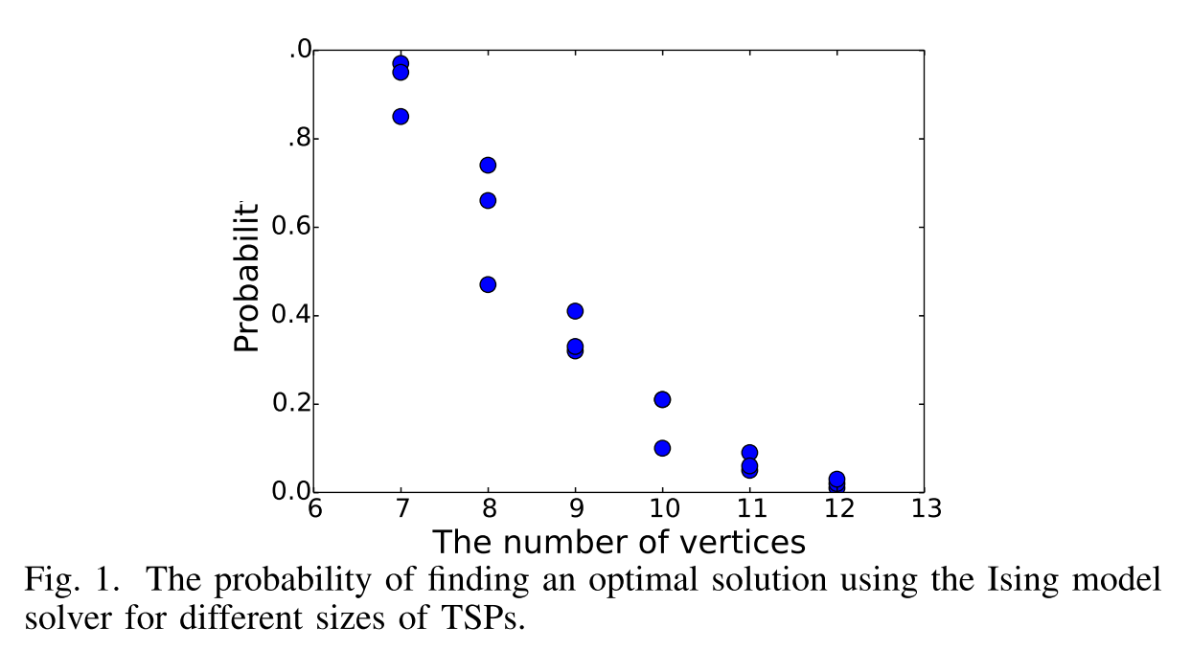
Solving TSPs using the Ising model-based solver (cont.)
Several issues when using this setup:
The graph becomes quadratically large
Solutions fail to satisfy the constraints with quality
If the constraint term is emphasized, the solution quality will signiﬁcantly deteriorate
Naïve Ising model solvers are used, the probability of obtaining an optimal solution is very low for TSPs of any useful size.

Slide 9
Proposed Algorithm
The travel route is reﬁned by a hierarchical application of clustering and Ising-based optimization
The vertices are clustered to limit the visiting order of the vertices, and thereby eliminates the spins and their interactions.
The probability of obtaining solutions that satisfy the constraints is improved and the solution quality is also improved.

Slide 10
ii. BackGround: Ising model-based solver

Slide 11
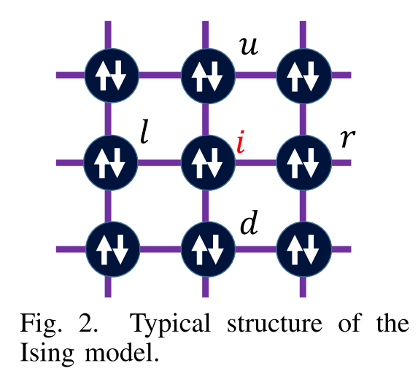
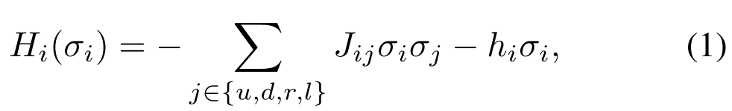
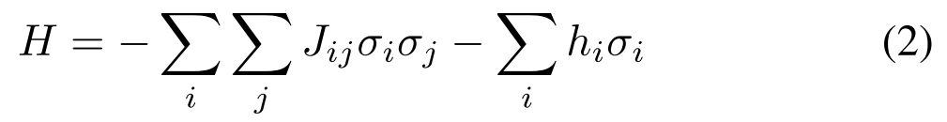
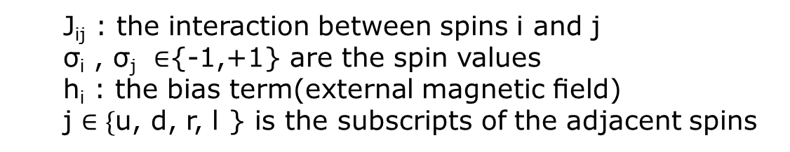
Spin energy (Objective function)
Lattice-like form
The local energy of spin i:
The total energy of the Ising model:
J_{ij} : the interaction between spins i and j
σ_{i} , σ_{j} ∈{-1,+1} are the spin values
h_{i} : the bias term(external magnetic ﬁeld)
j $∈\{$u, d, r, l } is the subscripts of the adjacent spins
Minimize this

Slide 12
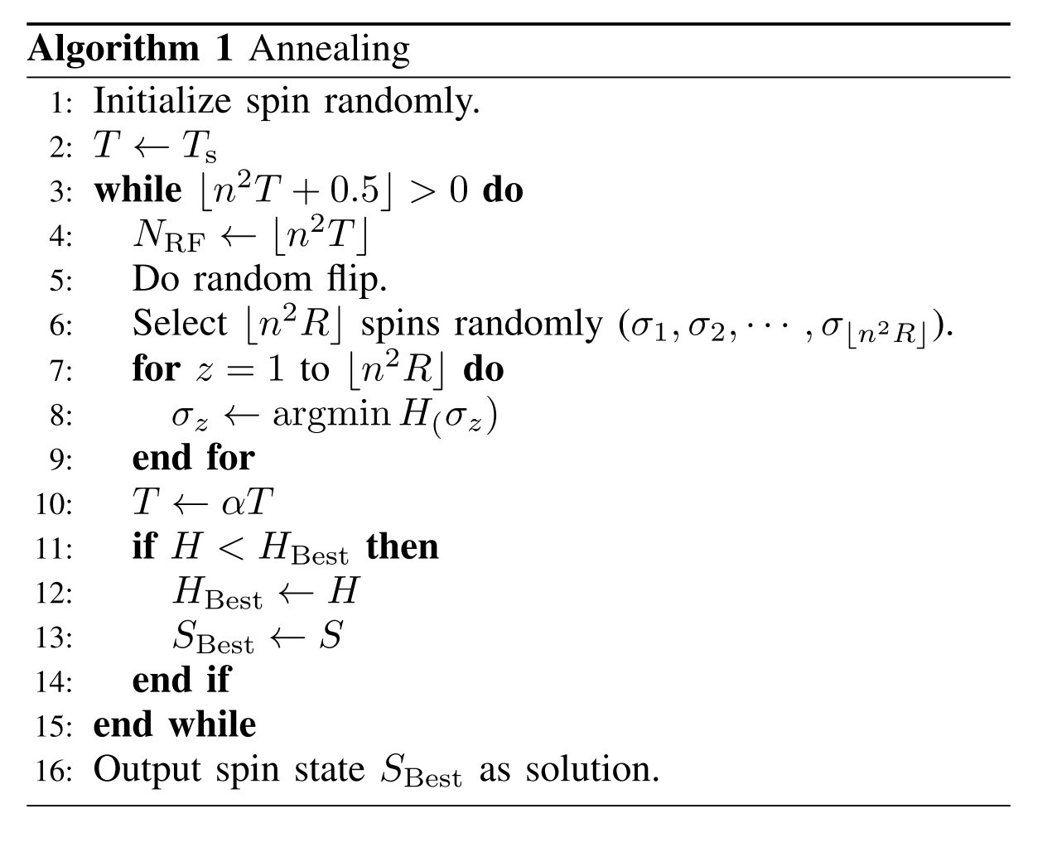
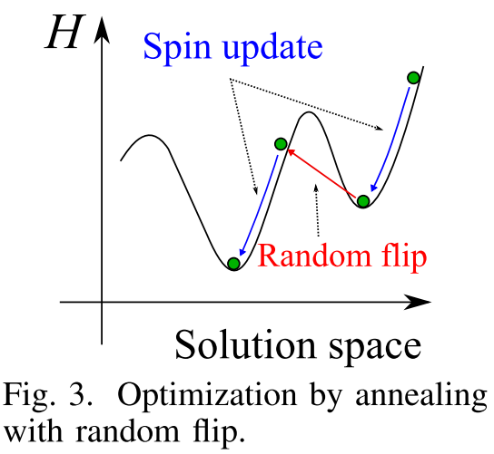
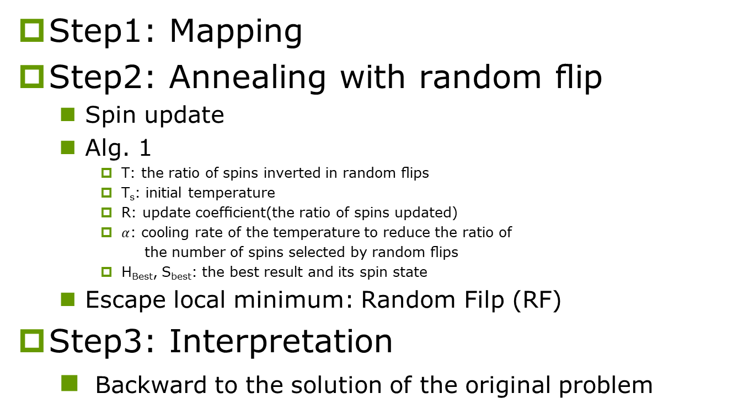
Three Steps:
Step1: Mapping
Step2: Annealing with random ﬂip
Spin update
Alg. 1
T: the ratio of spins inverted in random ﬂips
T_{s}: initial temperature
R: update coefﬁcient(the ratio of spins updated)
$α$: cooling rate of the temperature to reduce the ratio of
the number of spins selected by random ﬂips
H_{Best}, S_{best}: the best result and its spin state
Escape local minimum: Random Filp (RF)
Step3: Interpretation
Backward to the solution of the original problem

Slide 13
ii. BackGround: Solving the TSP using the Ising model-based solver

Slide 14
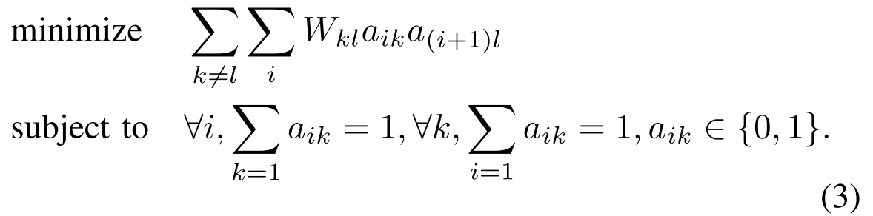
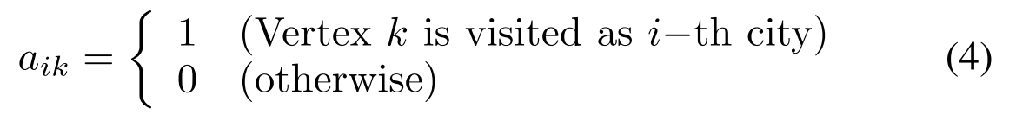
TSP
A n-vertices TSP is formulated as:
a_{ik} : vertex k is (is not) visited as the i-th city when a_{ik} = 1(0)
W_{kl} : the weight (or distance) between vertices k and l
Possible routes is (n - 1)! / 2
Difﬁcult to obtain its optimal solution by brute force methods as n becomes larger.

Slide 15
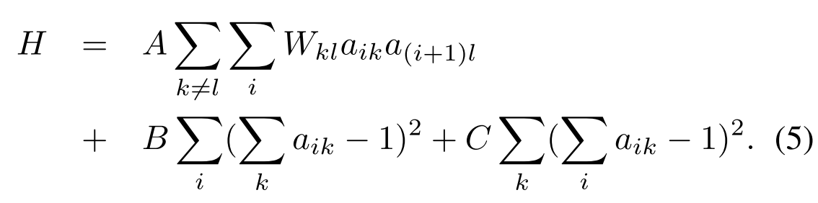
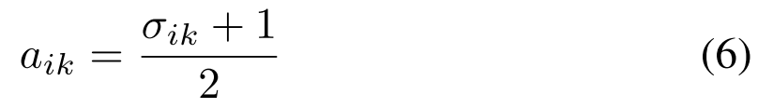
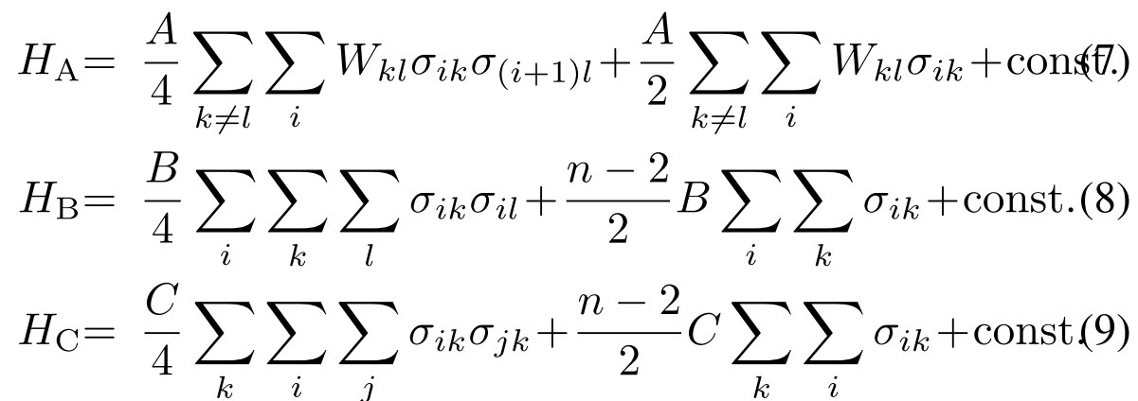

Step1: Mapping
Consider the energy function of the quadratic, unconstrained binary optimization (QUBO) format [16], the TSP is expressed by:
a_{ik} $∈ \{0, 1\}$ is converted to Ising model spin σ_{ik} ∈{-1,+1}
The ﬁrst, second, and third terms of Eq. (5) are represented as follows, respectively.
penalty(visit vertex i twice or more )
objective function penalty(visit several at the same time)

Slide 16
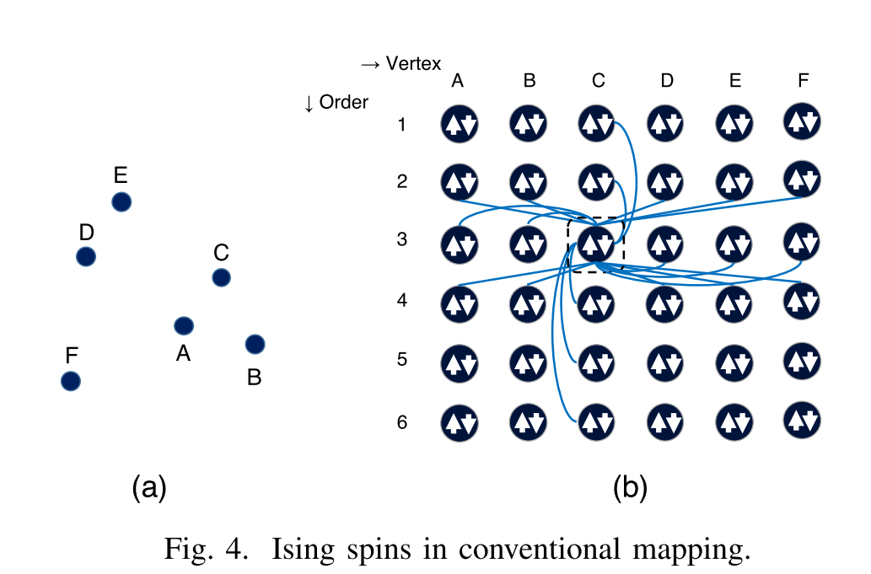
Step1: Mapping (cont.)
Typically, for hardware-based Ising model-based solvers, the number of interactions that can be coupled to a spin is limited due to routing congestion.
As shown in Fig. 4, σ_{ik} is fully connected by:
σ_{i*}
σ_{*k}
σ_{i-1,*,} σ_{i+1,*} (the row numbers are wrapped around for the circuit to close)
Mapping using hardware becomes very difﬁcult as n becomes larger

Slide 17
Step2: Random ﬂip for TSP
During the procedures, random ﬂips bring the spins to a state that does not satisfy the constraints in Eqs. (8) and (9)
In order to cause the spins to satisfy the constraints, we assign heavier weights for H_{B} and H_{C} .
The constraints may be satisﬁed but the solution obtained deteriorates.
If the hyperparameters for the constraints are weakened, we may end up with no solution that satisﬁes the constraints.

Slide 18
Step3: Interpretation
After repeating annealing with random ﬂips, the spin states will be interpreted as the solution for the TSP.
Legal solution:
All rows and all columns, there is only one spin that is valued at 1, and those of other spins are all -1.
Illegal solutions are practically useless.
Good hyperparameter set is difﬁcult
Satisfy vs Quality

Slide 19
Iii. HIERARCHICAL ISING MODEL SOLVER (This paper proposed)

Slide 20

Key Concept
In the conventional Ising model-based solvers, the solutions that are both legitimate and of high quality are increasingly difﬁcult to obtain as the size of the problem becomes larger.
They proposed a hierarchical clustering approach.
v_{p,k} is a coordinate of the vertices and p distinguishes the TSPs in different hierarchies
The number of the vertices is n_{p} for the TSP of the p-th hierarchy

Slide 21
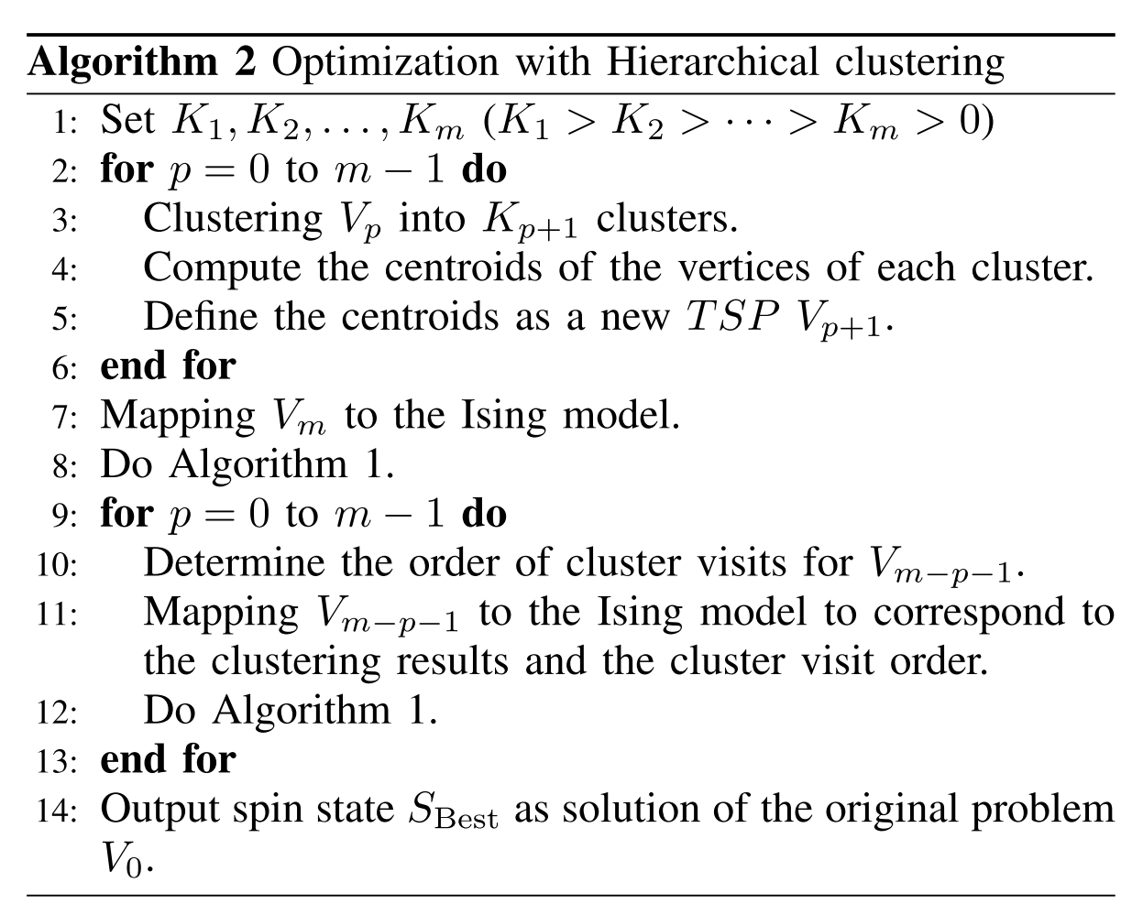
Key Concept (cont.)
Two phases:
Hierarchical vertex clustering (line 2-6)
Incremental annealing (line 7-13)
Incremental annealing

Slide 22
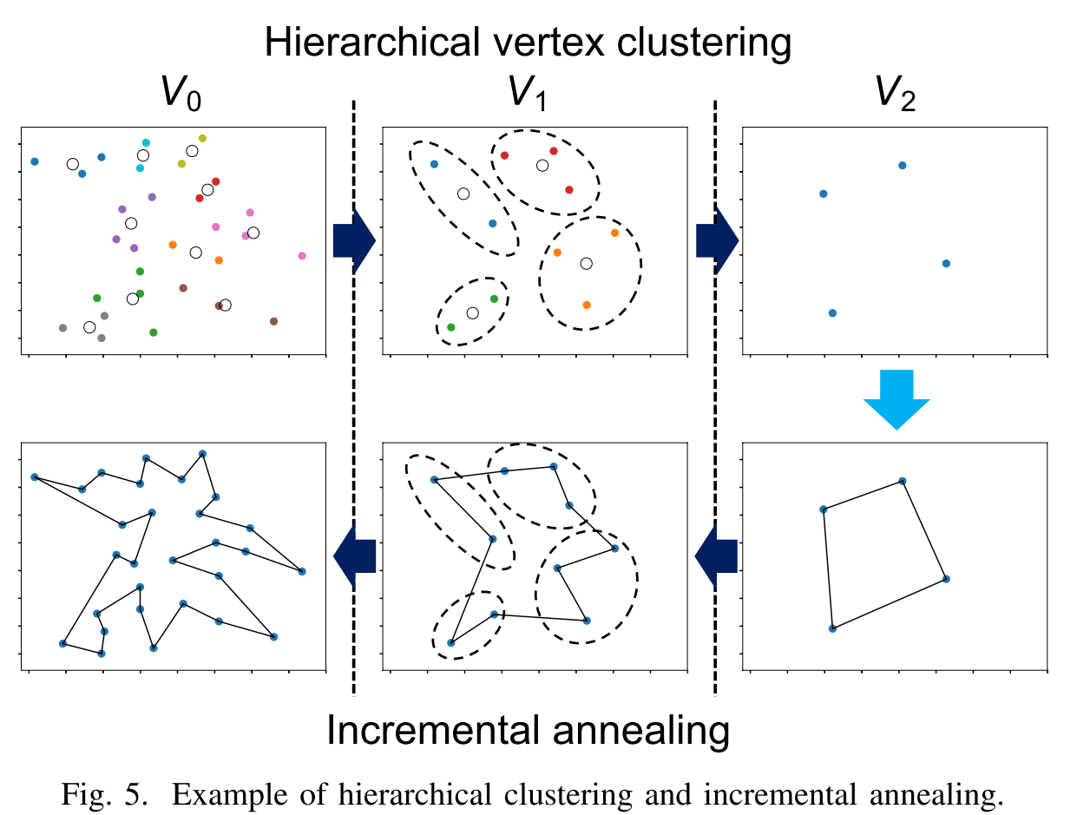
Example

Slide 23
Step1: Hierarchical vertex clustering
V₀ is the original TSP
First cluster: according to their spatial proximity
V_{i+1}: the centroids of the clusters in V₀
Recursively repeated until the number of nodes becomes sufﬁciently small for easy solution by the Ising model

Slide 24
Step2: Incremental annealing
Once the number of vertices has become tractable, we then begin to incrementally solve the newly deﬁned TSPs.

Slide 25
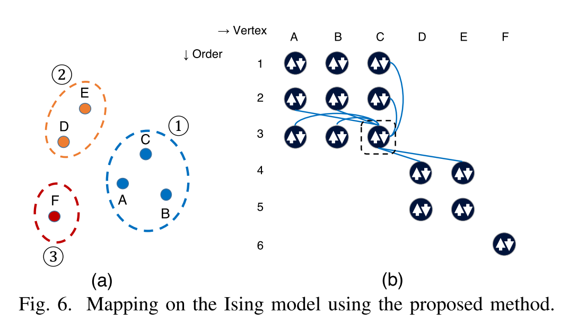
Example (Step2)
Fig. 6(a) shows the clusters of nodes in level k. In the coarsest level, k + 1, the visit order has been determined as shown by the numbers in circles.
Reduces the complexity of the calculations.

Slide 26
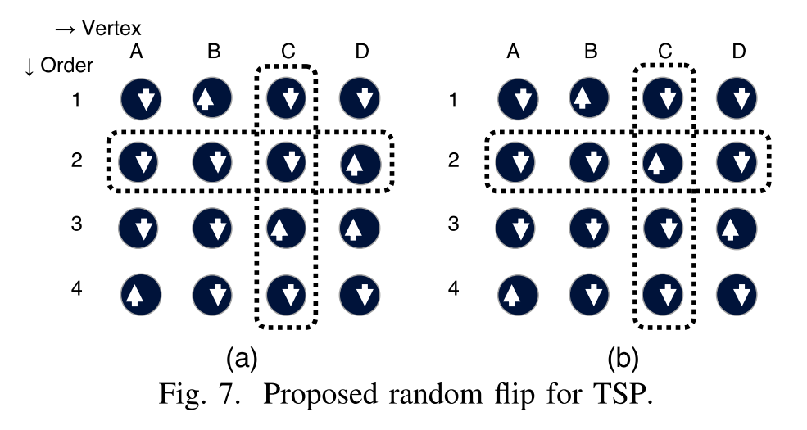
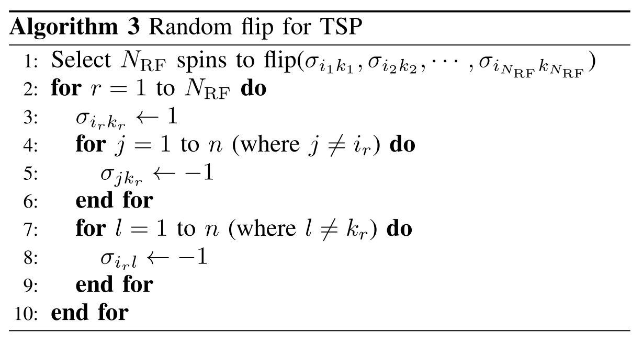
Modified Random ﬂip for TSP
A randomly selected spin σ_{ik} is forced to be 1, and the other spins in the same column and in the same row are forced to be -1.

Slide 27
Iv. NUMERICAL EVALUATION

Slide 28
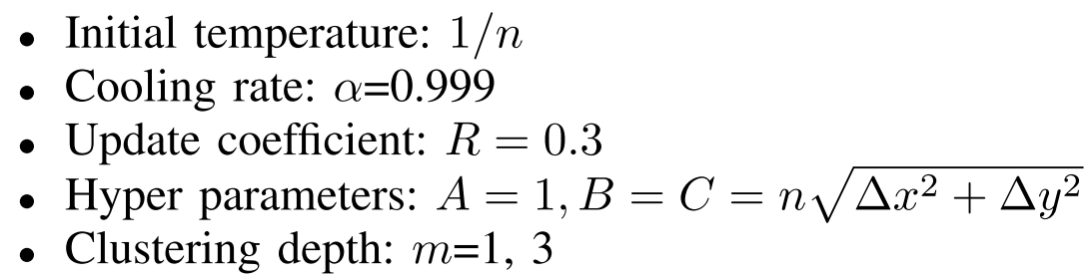
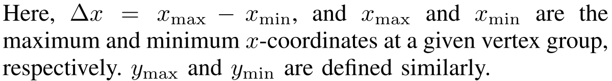
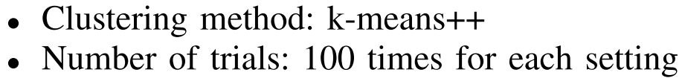
Settings
Parameters
Benchmark
TSPLIB [19] were solved: burma14, ulysses16, ulysses22, bays29, berlin52, eil76, and eil101.

Slide 29
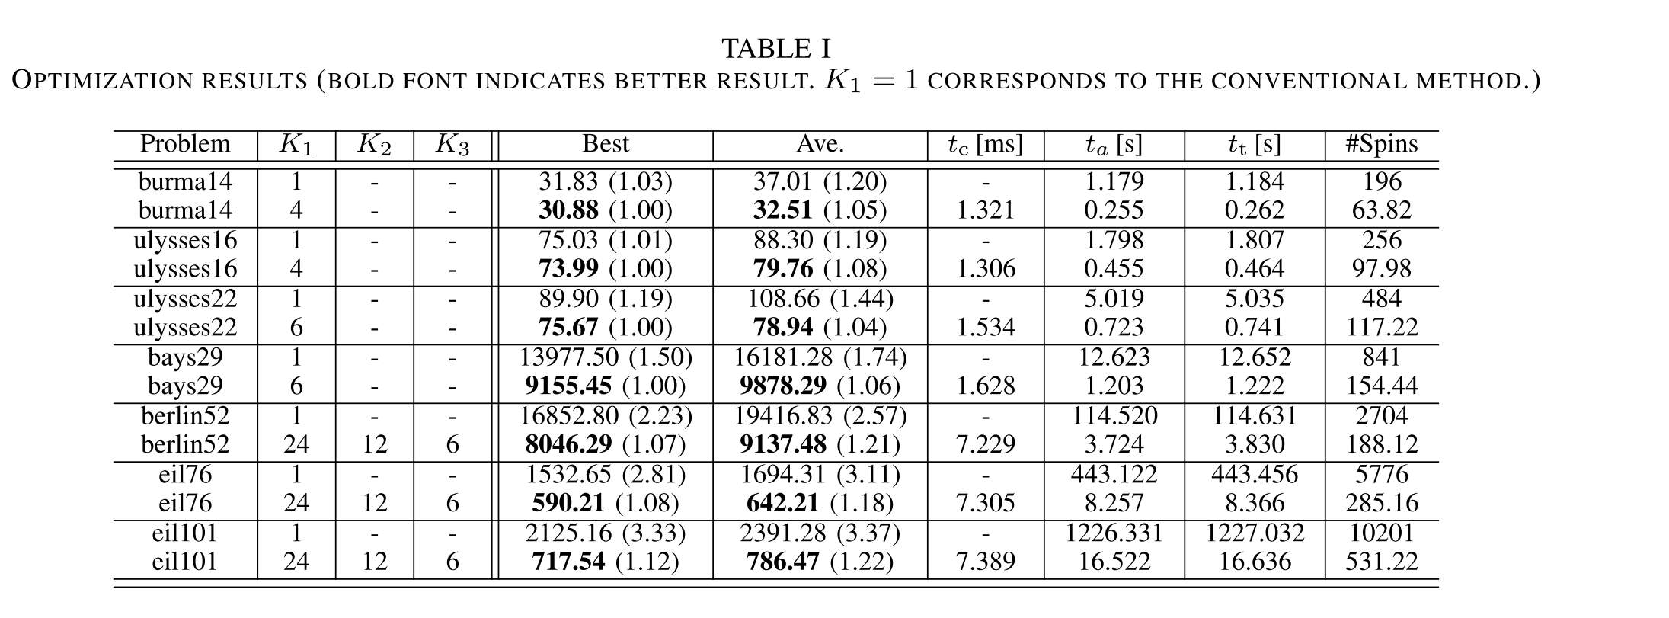
Optimization results(100 trials)
The solution quality of the proposed method has been improved by up to 67.1% while the runtimes have become 73.8x shorter than when using the conventional method. (in eil101)

Slide 30
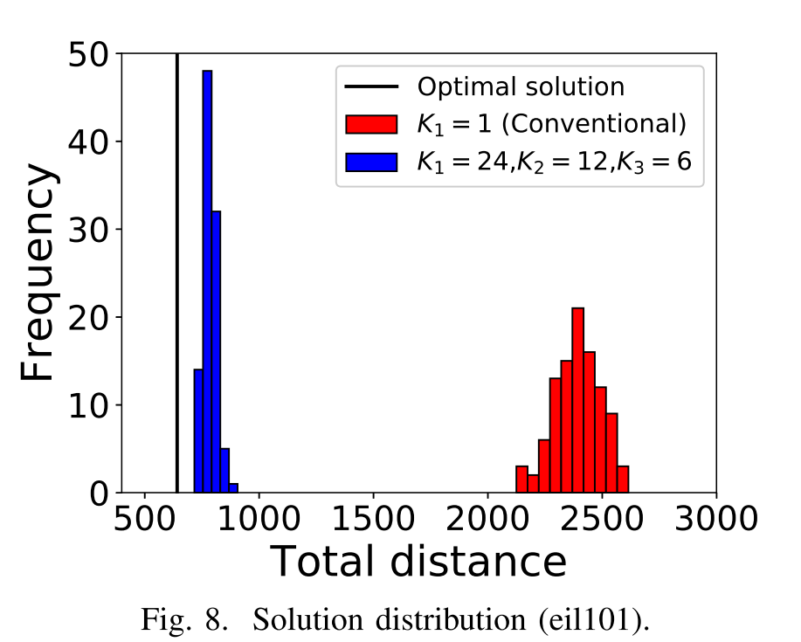
Result

Slide 31
v. Conclusion

Slide 32
Conclusion
In this paper, they proposed a hierarchical clustering approach for solving TSPs using the Ising model-based solver.
Benchmark problems were solved by the existing method and by the proposed method using the Ising model based solver and were compared.
The solution quality of the proposed method has been improved by up to 67.1% while the runtimes have become 73.8x shorter than when using the conventional method.

Slide 33
Reference
[1] S. Kirkpatrick, C. D. Gelatt, and M. P. Vecchi, “Optimization by simulated annealing,” Science, vol. 220, no. 4598, pp. 671–680, 1983.
[2] G. A. Kochenberger, J.-K. Hao, Z. L¨u, H. Wang, and F. Glover, “Solvinglarge scale Max Cut problems via tabu search,” J. Heuristics, vol. 19 no. 4, pp. 565–571, 2011.
[3] K.-L. Du and M. N. S. Swamy, Search and optimization by metaheuris- tics. Springer International Publishing, 2016.
[4] M. Yamaoka, C. Yoshimura, M. Hayashi, T. Okuyama, H. Aoki, and H. Mizuno, “20k-spin Ising chip for combinational optimization problem with CMOS annealing,” in Dig. Tech. Papers, IEEE Intl. Solid-State Circuits Conf., Feb 2015, pp. 1–3.
[5] P. L. McMahon, A. Marandi, Y. Haribara, R. Hamerly, C. Langrock, S. Tamate, T. Inagaki, H. Takesue, S. Utsunomiya, K. Aihara et al., “A fully programmable 100-spin coherent Ising machine with all-to-all connections,” Science, vol. 354, no. 6312, pp. 614–617, 2016.
[6] H. Gyoten, H. Hiromoto, and T. Sato, “Enhancing the solution quality of hardware Ising-model solver via parallel tempering,” Proc. IEEE/ACM Intl. Conf. on Computer-Aided Design, pp. 70:1–70:8, 2018.
[7] H. Nishimori, Statistical physics of spin glasses and information pro- cessing. Oxford University Press, 2001.
[8] T. Kadowaki and H. Nishimori, “Quantum annealing in the transverse Ising model,” Physical Review E, vol. 58, no. 5, pp. 5355–5363, 1998.
[9] M. Yamaoka, C. Yoshimura, M. Hayashi, T. Okuyama, H. Aoki, and H. Mizuno, “A 20k-spin Ising chip to solve combinatorial optimization problems with CMOS annealing,” IEEE J. Solid-State Circuits, vol. 51, no. 1, pp. 303–309, 2016.
[10] C. Cook, H. Zhao, T. Sato, M. Hiromoto, and S. X.-D. Tan, “GPU- based ising computing for solving max-cut combinatorial optimization problems,” Integration, vol. 69, pp. 335 – 344, 2019. [Online]. Available: http://www.sciencedirect.com/science/article/pii/S0167926019301348

Slide 34
Reference (cont.)
[11] M. Erol and F. Bulut, “Real-time application of travelling salesman prob- lem using google maps api,” Electric Electronics, Computer Science, Biomedical Engineerings’ Meeting, pp. 1–5, 2017.
[12] R. Takahashi, “Quantitative evaluation of iterative extended changing crossover operators to solve the traveling salesman problem: Diversity measurement and its application to selection strategies in genetic algorithms,” Intl. Conf. on Natural Computation, pp. 235–244, 2014.
[13] M. Dorigo and L. M. Gambardella, “Ant colony system: a cooperative learning approach to the traveling salesman problem,” IEEE Transactions on evolutionary computation, vol. 1, no. 1, pp. 53–66, 1997.
[14] H. Gyoten, M. Hiromoto, and T. Sato, “Area efﬁcient annealing processor for ising model without random number generator,” IEICE Trans. Information and Systems, vol. E101-D, no. 2, pp. 314–323, 2018.
[15] A. Zaribaﬁyan, D. Marchand, and S. Rezaei, “Systematic and deterministic graph minor embedding for cartesian products of graphs,” Quantum Information Processing, vol. 16, no. 5, p. 136, 2017.
[16] E. Boros, P. Hammer, and G. Tavares, “Local search heuristics for quadratic unconstrained binary optimization (QUBO),” J. Heuristics, vol. 13, no. 2, pp. 99–132, 2007.
[17] S. Kanamaru, D. Oku, M. Tawada, S. Tanaka, M. Hayashi, M. Yamaoka, M. Yanagisawa, and N. Togawa, “Efﬁcient Ising model mapping to solving slot placement problem,” IEEE Itnl. Conf. Consumer Electronics, pp. 1–6, 2019.
[18] J. Cai, W. G. Macready, and A. Roy, “A practical heuristic for ﬁnding graph minors,” 2014.
[19] “TSPLIB,” softlib.rice.edu/pub/tsplib/tsp/.

Slide 35
THANK YOU

